Slide 1
Research Platform for Custom Memory Cube
Yu Zou
Vinayak Deshpande
Peter Harduvel
Dr. Herman Lam
Assoc. Professor of ECE
University of Florida

Slide 2
Outline
Review & overview
Notional CMC architecture
Performance measurements on Merlin board
Mapping notional CMC to Merlin board
Experiments & measurements
Non-overlapping memory access
Simple read & write ops, DRE ops
Overlapping memory access
Simple read & write ops, DRE ops
Simplified CMC-to-Merlin mapping
Application of simplified mapping to DRE option 2
Going forward
* DRE: Data rearrangement/reordering engine ** CMC Computational Memory Cube

Slide 3
Outline
Review & overview
Notional CMC architecture
Performance measurements on Merlin board
Mapping notional CMC to Merlin board
Experiments & measurements
Non-overlapping memory access
Simple read & write ops, DRE ops
Overlapping memory access
Simple read & write ops, DRE ops
Simplified CMC-to-Merlin mapping
Application of simplified mapping to DRE option 2
Going forward
* DRE: Data rearrangement/reordering engine ** CMC Computational Memory Cube

Slide 4
Notional CMC Architecture*
I thought we decided to delete the Delay boxes on the link? If so, do so all slides.
Why is there a VB in this general CMC arch?
Based on Nair et al.* : an HMC with a user-programmable logic layer
A, B, C, D, and : performance-measurement points of interest
* Nair, R., et al. "Active Memory Cube: A processing-in-memory architecture for exascale systems.“ IBM Journal of Res. & Development 59.2/3 (2015): 17-1.
Notes:
You need to address my two comments in yellow boxes.
I modified the bullets to emphasize the 2 take-away points for this slide

Slide 5
DRE* Prototype on CMC Architecture
I thought we decided to delete the Delay boxes on the link? If so, do so all slides.
VB3
VB2
VB1
VB3
View buffer (VB) can be set up on host (design option 1), inside the HMC (design option 2) or inside CMC logic (design option 3)
* DRE: Data Reordering/Rearrangement Engine Lawrence Livermore Nat. Labs
Notes:
Same comment about “Delay boxes” in the links.
I modified the animation to be consistent with the ordering of 1, 2, and 3.

Slide 6
Performance Measurement on Merlin Board
CMC platform on Merlin board
**
M3 M4 M5
E’
Instrumented Merlin infrastructure with hardware performance monitors
A’, B’, C’, D’, M1, M2, M3, M4, M5, and E’
Progress: Able to measure all listed parameters except:
M4, M5: Exploring with help from Convey
E’: Exploring with help with Micron under NDA
Notes:
Removed F3 on top of slide;
I changed the colors to make the bullets and figure consistent. Please make sure you do the same when creating slides in the future.

Slide 7
Mapping Notional CMC onto Merlin Board
Merlin board
Case study: model of a notional CMC
Simplifying assumption:
For this model, this part of CMC is assumed to have an HMC architecture
I thought we decided to delete the Delay boxes on the link? If so, do so all slides.
Notes:
I tried to make the take-away point more obvious:
Add yellow boxes to draw attention to them
State take-away point
This is something you need to learn to do.
Make clear in your mind what is the take-away point of the slide?
Make the take-away point clear IN THE SLIDE (either by a bullet or some graphics)

Slide 8
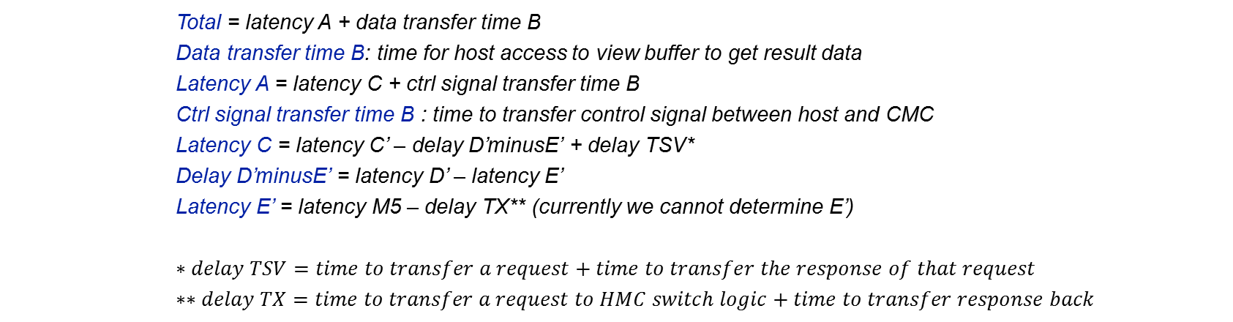


Model of CMC-to-Merlin Mapping
Model of notional CMC
CMC platform on Merlin board
Original slide 8: Model of CMC-to-Merlin Mapping; see next slide for my modification
**
$$TX$$
M3 M4 M5
E’
$$delay D^{′}minusE^{′}$$
Total = latency A + data transfer time B
Data transfer time B: time for host access to view buffer to get result data
Latency A = latency C + ctrl signal transfer time B
Ctrl signal transfer time B : time to transfer control signal between host and CMC
Latency C = latency C’ – delay D’minusE’ + delay TSV*
Delay D’minusE’ = latency D’ – latency E’
Latency E’ = latency M5 – delay TX** (currently we cannot determine E’)
$$∗delay TSV=time to transfer a request+time to transfer the response of that request$$
$$∗∗delay TX=time to transfer a request to HMC switch logic+time to transfer response back$$
Latency: round-trip delay from input into a point in the system to desired outcome

Slide 9
Model of CMC-to-Merlin Mapping
I thought we decided to delete the Delay boxes on the link? If so, do so all slides.
Model of notional CMC
CMC platform on Merlin board
**
$$TX$$
M3 M4 M5
E’
$$delay D^{′}minusE^{′}$$
Latency A = ctrl signal transfer time B + latency C + result transfer time B
Ctrl signal transfer time B : time to transfer control signals between host and CMC
Data transfer time B: time for host access to obtain result (e.g., transfer from view buffer)
Latency C = latency C’ – delay D’minusE’ + delay TSV*
Delay D’minusE’ = latency D’ – latency E’
* delay TSV = between DRE core and switch, time to transfer a request +
time to transfer response of that request
Latency: round-trip delay from input into a point in the system to desired outcome
Notes:
I changed the first few bullet for latency A; hopefully simpler and more clear.
I added “Between DRE core and switch” for the footnote for delay TSV
Added animation
I deleted the following bullets completely. All they do is to cause confusion (see my reasons below)
Latency E’ = latency M5 – delay TX** (currently we cannot determine E’)
* * delay TX = time to transfer a a request to HMC switch logic + time to transfer response back
Reasons for the deletion:
- We don’t need E’ for now.
- Even if we do need E’ later, we assume that we will be able to measure it (with Micron’s help)

Slide 10
Outline
Review & overview
Notional CMC architecture
Performance measurements on Merlin board
Mapping notional CMC to Merlin board
Experiments & measurements
Non-overlapping memory access
Simple read & write ops, DRE ops
Overlapping memory access
Simple read & write ops, DRE ops
Simplified CMC-to-Merlin mapping
Application of simplified mapping to DRE option 2
Going forward
* DRE: Data rearrangement/reordering engine ** CMC Computational Memory Cube

Slide 11
Review of DRE setup, fill, drain
void setup(value_pointer refp, index_pointer indexp, value_pointer sp)
{
ref_base = refp;
idx_base = indexp;
scratchpad = sp;
}
void fill() {
for (size_t i = 0; i < scratchpad.length(); i++) {
scratchpad[i] = ref_base[idx_base[i]];
}
}
void drain() {
for (size_t i = 0; i < scratchpad.length(); i++) {
ref_base[idx_base[i]] = scratchpad[i];
}
}

Slide 12
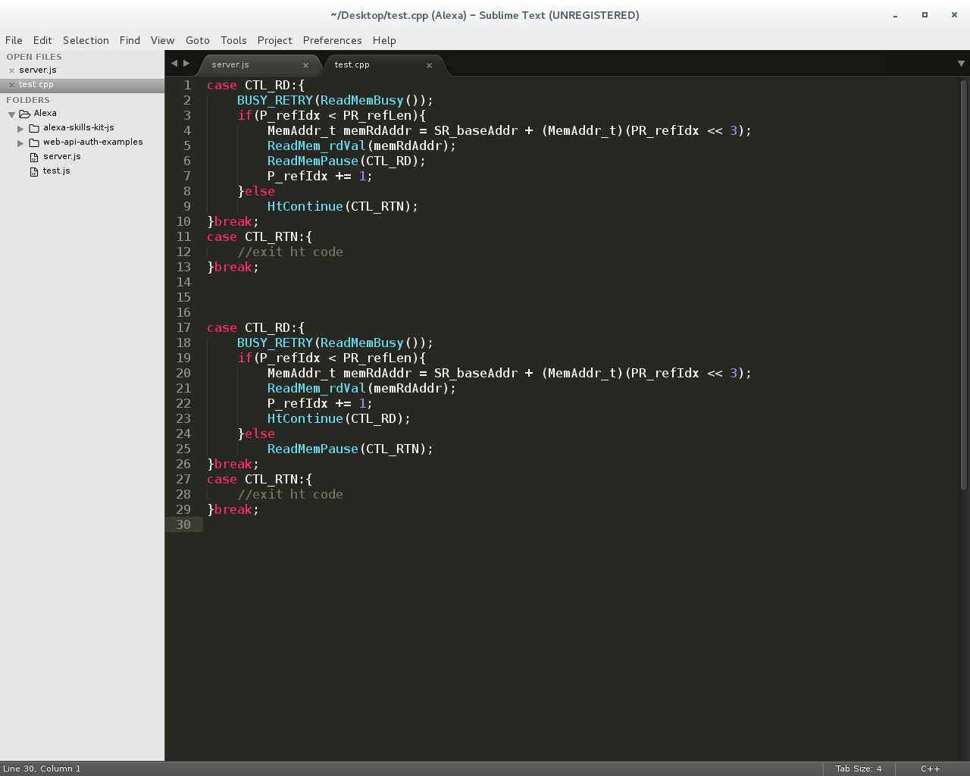
Memory Access on Merlin Board
Non-overlapping memory access
Overlapping memory access
Wait for data return before issuing next memory request
Send next memory request immediately after sending previous one
Barrier synchronization to guarantee all responses are returned before exiting code
Notes:
I changed the animation a little bit

Slide 13
Non-overlapping Memory Access
Measured performance: simple read/write (µs) (Averaged over 100,000 iterations)
Oper. | A’ (µs) | C’ | D’ | M1 | M2 | M3
Read | 1095.6 | 1.03 | 1.006 | 0.923 | 0.725 | 0.519
Write | 1104.0 | 1.071 | 1.011 | 0.991 | 0.793 | 0.577
Measured performance: Vector Addition in ms (100,000 iterations of 2 reads & 1 write)
A’ (ms) | C’ | D’ | M1 | M2 | M3
282.55 | 281.72 | 278.72 | 258.96 | 199.68 | 151.31
Measured performance: SpMV – DRE app in seconds (2²⁴ X 2²⁴ matrix)
A’ (s) | C’ | D’ | M1 | M2 | M3
1658.67 | 1580.14 | 1559.65 | 1460.57 | 1122.42 | 839.84
Observation consistent with expectation: M1 > M2 > M3 (> M4 > M5 > E’)

Slide 14
Overlapping Memory Access: read/write ops
Observation: M1, M2, M3, (M4, M5, E’) have no significant difference

Slide 15
Overlapping Memory Access: DRE ops
Observation: M1, M2, M3, (M4, M5, E’) again have no significant difference
For overlapping memory access, discrepancy between M1, M2, M3, (M4, M5, E’) is hidden by “pipeline effect”
Simplified CMC modeling can be used
Notes:
Changed to “pipeline effort” vs. “pipeline”. I’m not sure we can expect perfect pipelining for overlapping memory accesses.
Put in a second take-away point.

Slide 16
Outline
Review & overview
Notional CMC architecture
Performance measurements on Merlin board
Mapping notional CMC to Merlin board
Experiments & measurements
Non-overlapping memory access
Simple read & write ops, DRE ops
Overlapping memory access
Simple read & write ops, DRE ops
Simplified CMC-to-Merlin mapping
Application of simplified mapping to DRE option 2
Going forward
* DRE: Data rearrangement/reordering engine ** CMC Computational Memory Cube

Slide 17
Simplified Notional CMC Modeling
For pipelined overlapping memory operations, estimate:
M1 = M2 = M3 = M4 = M5 = E’
I thought we decided to delete the Delay boxes on the link? If so, do so all slides.
Model of notional CMC
CMC platform on Merlin board
**
$$TX$$
M3 M4 M5
E’
$$delay D^{′}minusE^{′}$$
Total = latency A + data transfer time B
Data transfer time B: time for host access to view buffer to get result data
Latency A = latency C +ctrl signal transfer time B
Ctrl signal transfer time B : time to transfer control signal between host and CMC
Latency C = latency C’ – delay D’minusE’ + delay TSV*
Delay D’minusE’ = latency D’ – latency E’
Latency E’ = latency M5 – delay TX** (currently we cannot determine E’)
If you agree with the new Slide 9 (Model of CMC-to-Merlin Mapping), these equations needs to be changed.
Latency: round-trip delay from input into a point in the system to desired outcome

Slide 18
Simplified Notional CMC Modeling
For pipelined overlapping memory operations, estimate:
M1 = M2 = M3 = M4 = M5 = E’
I thought we decided to delete the Delay boxes on the link? If so, do so all slides.
Model of notional CMC
CMC platform on Merlin board
**
$$TX$$
M3 M4 M5
E’
$$delay D^{′}minusE^{′}$$
Total = latency A + data transfer time B
Data transfer time B: time for host access to view buffer to get result data
Latency A = latency C +ctrl signal transfer time B
Ctrl signal transfer time B : time to transfer control signal between host and CMC
Latency C = latency C’ + delay TSV*
* delay TSV = time to transfer request + time to transfer response
If you agree with the new Slide 9 (Model of CMC-to-Merlin Mapping), these equations needs to be changed.
Latency: round-trip delay from input into a point in the system to desired outcome

Slide 19
Outline
Review & overview
Notional CMC architecture
Performance measurements on Merlin board
Mapping notional CMC to Merlin board
Experiments & measurements
Non-overlapping memory access
Simple read & write ops, DRE ops
Overlapping memory access
Simple read & write ops, DRE ops
Simplified CMC-to-Merlin mapping
Application of simplified mapping to DRE option 2
Going forward
* DRE: Data rearrangement/reordering engine ** CMC Computational Memory Cube

Slide 20
Scope and Parameter Definition
Current scope: 1 link, 1 CMC core architecture
Scale and parameterized in future (n links, m core)
1 CMC Core
I thought we decided to delete the Delay boxes on the link? If so, do so all slides.
1 link
Link parameters:
BW_{link}: Bandwidth of host-CMC interface (bit/s)
W_{host-cmc}: Bit width of host-CMC message (request + response) (bit)
Data: W_{host-cmc}(data)
Ctrl: W_{host-cmc}(ctrl)
TSV parameters
BW_{TSV}: Bandwidth of TSV connection (bit/s)
W_{core-vc}: Bit width of core-vault message (request + response) (bit)

Slide 21
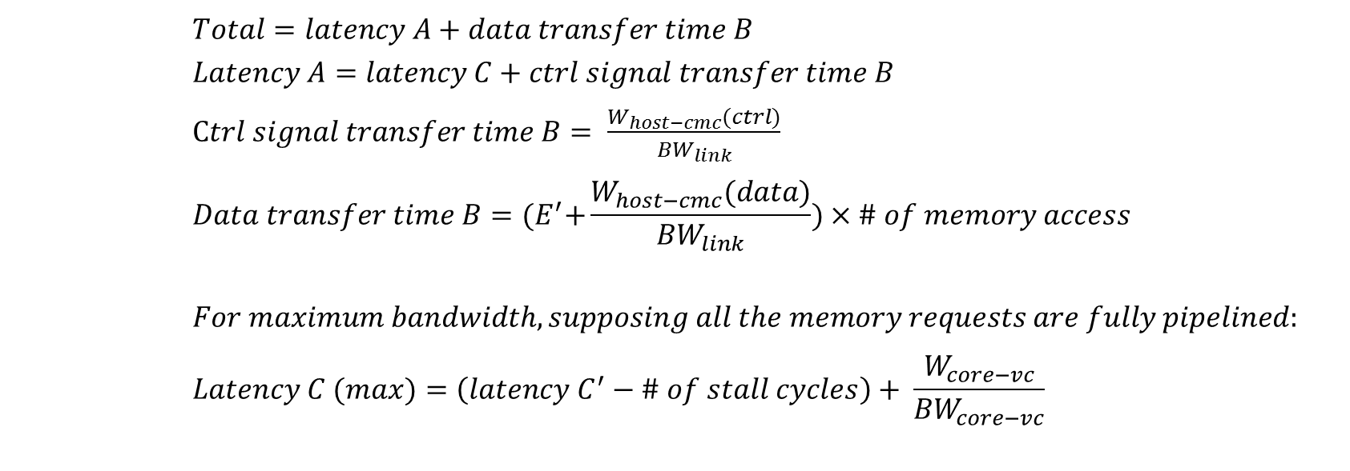
Best-case Performance (Design Op3, 1 link, 1 CMC core)
Model of notional CMC
CMC platform on Merlin board
Isn’t this Design Option 2 in Slide 5?
**
Explain to me in meeting why this is best-case.
M3 M4 M5
$$TX$$
E’
$$delay D^{′}minusE^{′}$$
$$Total=latency A+data transfer time B$$
$$Latency A=latency C+ctrl signal transfer time B$$
$Ctrl signal transfer time B= \frac{W_{host−cmc}(ctrl)}{{BW}_{link}}$
$$Data transfer time B={(E}^{′}+\frac{W_{host−cmc}(data)}{{BW}_{link}})×\# of memory access$$
$$For maximum bandwidth, supposing all the memory requests are fully pipelined:$$
$$Latency C (max)=\left(latency C^{′}−\# of stall cycles\right)+ \frac{W_{core−vc}}{{BW}_{core−vc}}$$

Slide 22
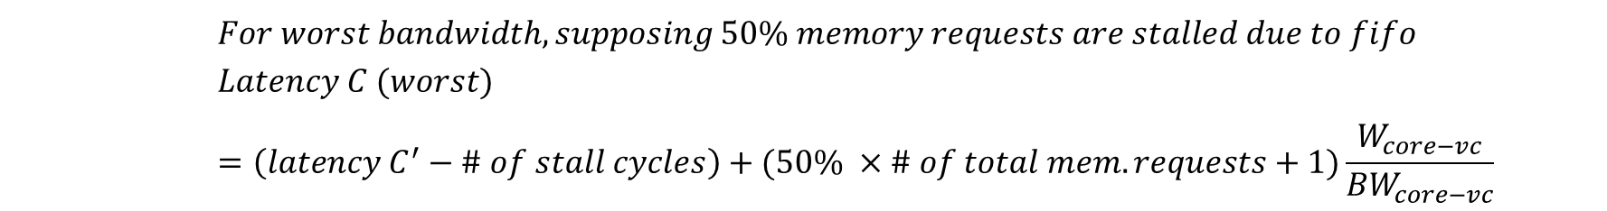
Worst-case performance (Design Op3, 1 link, 1 CMC core)
Model of notional CMC
CMC platform on Merlin board
Isn’t this Design Option 2 in Slide 5?
**
Why is 50% the worst case (may need a better name)
M3 M4 M5
$$TX$$
E’
$$delay D^{′}minusE^{′}$$
May have several: 75%, 50%, 25%??
$$For worst bandwidth, supposing 50\% memory requests are stalled due to fifo$$
$$Latency C (worst)=\left(latency C^{′}−\# of stall cycles\right)+(50\% ×\# of total mem. requests+1)\frac{W_{core−vc}}{{BW}_{core−vc}}$$

Slide 23
Case Study Result for Random Access App.
What is the take-away point(s)?
Important: what are the take-away points for this slide??
What is the take-away point(s)?
Important: what are the take-away points for this slide??
Notes:
I changed the animation.
Looking at this slide, I can’t figure out the take-away point(s).

Slide 24
Going Forward
Creating user-friendly CMC API
Share code and lessons with LPS
Visit LPS at some time
Continue researching on CMC modelling for multiple links multiple CMC cores
Study sorting and bloom filter on CMC

